Slide 1
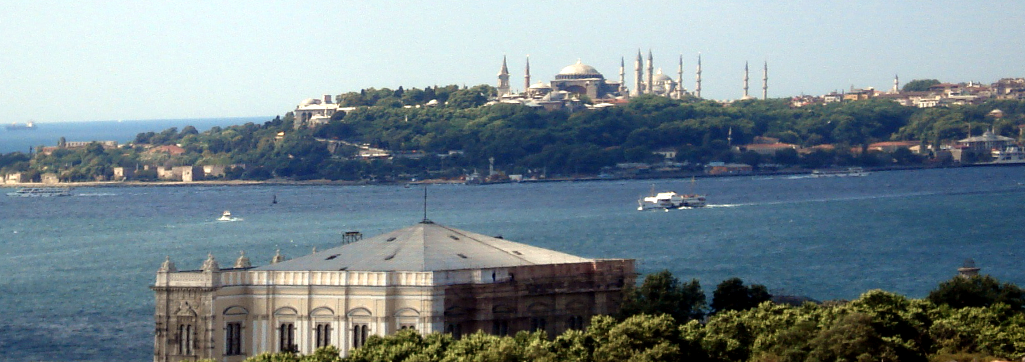
Presentation
Istanbul – 12.4.2014

Slide 2
The Turkish Mathematical Society (TMD) was founded in 1948.
It was the only professional institution representing and bringing together mathematicians in Turkey until 1995.

Slide 3
TMD FACTS
TMD has 818 members from all over the country.
It has been a full member of the IMU since 1960 and a full member of the EMS since 2008.
The Society’s center is located in Istanbul and it has also a branch in Ankara.

Slide 4
FACTS and FIGURES in TURKEY
In Turkey, there are
    106 math departments
    ~ 20,000 math undergraduates
    ~ 600 math graduate students
    ~ 90 math PhDs per year
    ~ 1600 math professors
    ~ 500 SCI math publications per year

Slide 5
TMD MISSION
The main objective of the TMD is to sustain the advancement and nationwide augmentation of mathematics, mathematical sciences and related disciplines.
To reach our goal, we advocate the effectiveness of mathematics in sociological, economical and technological context, as well as its vocational significance.
In addition, we support research and scholarships, promote mathematics education and the exposition of mathematics at all levels through appropriate venues, e.g. government, national funding agencies, media.

Slide 6
MAIN TMD ACTIVITIES
Annual National Math Symposia
Undergraduate Scholarships
Quarterly Popular Math Magazine
Popular Math Seminars for Public
Graduate Summer Schools

Slide 7
NATIONAL SYMPOSIA
The Society provides nationwide resources and activities that foster professional growth and cooperation among researchers, academicians, teachers and students.
To this end, TMD organizes an annual national symposium in different regions of the country.
So far, 25 symposia have been organized at twenty Turkish universities.
Each year, hundreds of academicians attend these symposia to collaborate over research and benefit from lectures presented by researchers who are selectively invited by a scientific advisory committee.
Through the organization of special sessions, young researchers are given the opportunity to present their theses, and thus, a professional platform for discussing their ideas is provided.

Slide 8
FELLOWSHIPS
TMD offers three fellowships per year, supporting three math undergraduates who are selected by a fellowship committee upon application:
    Cahit Arf fellowship
    Gündüz Ikeda fellowship
    Nazım Terzioğlu fellowship

Slide 9
PUBLIC EVENTS
We influence institutional and public policy through the emphasis of the need for the application of mathematics within other fields.
Moreover, we promote a general understanding and appreciation of mathematics by organizing monthly popular math seminars appealing to a general audience, to the benefit of educators and students.

Slide 10
POPULAR MATH MAGAZINE
TMD publishes quarterly a popular math magazine, “MATEMATİK DÜNYASI” (“The World of Mathematics”), capturing public interest.
It is selling over 10,000 copies per issue, and very popular among high school and undegraduate students.
The magazine is designed to encourage students of all ages to pursue activities and careers in the mathematical sciences.
Successive issues are dedicated to specific subjects covering contemporary advancements in mathematics.

Slide 11
OTHER ACTIVITIES
Annual Algebra Workshops
Graduate Summer Schools
These activities, fostering graduate students are conducted regularly and, in addition to facilitating research, give novice researchers the chance to interact with and learn from expert researchers.

Slide 12
THANK YOU FOR YOUR ATTENTION

